Slide 1



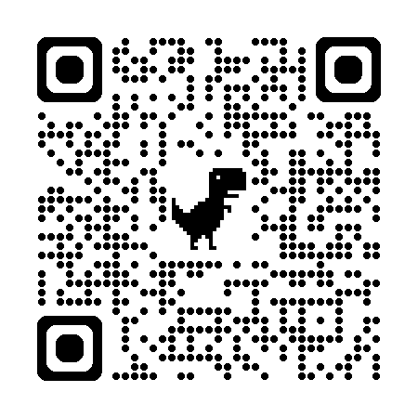
Intern Code Blue and Rapid Response Leadership
Rhythm-recognition confidence improved; team-leadership confidence did not — and prior exposure types diverged
Josiah Situmeang¹, MD; Alex Ryden¹, MD; Colton Long¹, MD; Ethan Krauspe¹, MD; Sumit Patel¹, MD; Richa Sheth¹, MD; Brian W. Locke², MD MSCI
1. University of Utah Internal Medicine Residency, Pulmonary & Critical Care Medicine Fellowship, Cardiovascular Diseases Fellowship; 2. Pulmonary & Critical Care Medicine, Intermountain Medical Center
RATIONALE
MAIN TAKEAWAY
FINDINGS
-
Residents are locally responsible for code and rapid response leadership. Learning occurs via exposure and simulation.
Prior rapid-response exposure tracked with lower team-management confidence; code and simulation exposure tracked with higher confidence.
The seminar produced a clear gain in rhythm-recognition confidence (+1.63 / 10).
No significant change in confidence regarding team-dynamics manage or in attending-call tendency.
31 pre-surveys
23 paired completions
74% completed pre and post
-
Traditional teaching emphasizes algorithms and technical steps, with less focus on leadership, communication, and team dynamics.
-
Codes attended (+0.49/event) and simulations completed (+0.47/event) were associated with higher team-leadership confidence; rapid-response attendance (-0.07/event) was not.
Changes in team-leadership confidence (1–10 scale)
-
Prior safety analyses and feedback highlight unclear leadership, missed shockable-rhythm decisions, and delayed escalation.
+0.49
+0.47
-0.07
-
The seminar produced a clear gain in rhythm-recognition confidence (+1.63/10).
per code blue attended
per simulation completed
per rapid response attended
95% CI: +0.13 to +0.81
95% CI: +0.03 to +0.94
95% CI: -0.17 to +0.03 (n.s.)
-
Team-dynamics confidence and attending-call tendency did not substantially change after the seminar.
CURRICULUM DESIGN
SURVEY RESPONSES
4 web-based modules (~60 min total), completed asynchronously prior to PGY-2 start.
Modules :
Leadership skills for code blue and rapid response teams
Rhythm strip recognition and management
Resources at the bedside (medications, equipment, roles)
Ending the event and structured debrief
Simulation block:
3 facilitated case scenarios with an intensivist
Hands-on Zoll defibrillator practice (defib, pacing, rhythm interpretation)
Group debrief after each scenario
Prior Event Experience (n=31, pre-survey)
Median [IQR]
Number of Rapid Responses Attended as an Intern
15 [10 to 17.5]
Helpfulness ratings: 9/10 median across modules, case simulation, and discussion.
Number of Code Blues Attended as an Intern
3 [1.5 to 4]
Number of Simulations Attended as an Intern
1 [0.25 to 2]
Ratings of Curricular Components (n=23, paired)
Median [IQR]
CONCLUSION
Perceived effectiveness of lecture modules (1-10)
9 [8 to 10]
Perceived effectiveness of case simulation (1-10)
9 [8 to 10]
This pattern suggests rapid-response exposure alone may not build team-leadership confidence; structured practice through codes and simulations appears more associated with it.
Perceived effectiveness of lecture discussion (1-10)
9 [7.5 to 10]
Team-Leadership Confidence Association with prior exposure (n=23, post-survey)
Change per event attended (95% CI)
Per rapid response attended
-0.07 (-0.17 to 0.03)
Per code blue attended
0.47 (0.03 to 0.94)
Per simulation attended
0.49 (0.13 to 0.81)
Future iterations will emphasize structured practice and feedback for uncertainty in rapid responses.
Findings reflect a single-center sample; non-completers (26%) may differ from completers.
METHODS
Pre-to-Post Change (n=23, paired)
Mean change (95% CI)
Team-dynamics confidence
-0.41 (-1.53 to 0.72)
-
Single-center IM residency.
Pre/post surveys rated self-reported confidence (not clinical competence) on five 1–10 items: code leadership, rapid-response leadership, rhythm interpretation, team dynamics, and attending-call tendency.
Attending-call tendency
0.05 (-0.56 to 0.65)
Rhythm strip recognition
1.63 (1 to 2.27)
Team-Leadership Confidence Effects — FOREST PLOT
Course materials
Mean change after seminar (top) and change per prior event attended (bottom), with 95% CI
Pre→post change after seminar
Course Materials:
Rhythm-strip recognition
+1.63
-
Post-seminar survey rated helpfulness of modules, clinical cases, and group debriefing.
Team-dynamics confidence
-0.41
Attending-call tendency
+0.05
Per prior event attended (leadership confidence)
Disclosures: The authors have no relevant disclosures.
Per code blue attended
+0.49
Thanks to the U of U IM residents and faculty intensivists who facilitated the simulation block, and to the program leadership for protected curricular time.
Per simulation attended
+0.47
-
Paired t-tests for pre→post change; linear regression for per-event slopes.
Per rapid response attended
-1
0
+1
+2
-0.07
← lower confidence
higher confidence →
1-10 Likert Scale
Code Blue & Rapid Response Seminar | American Thoracic Society 2026, Orlando FL
Contact: Josiah Situmeang, MD

